Slide 1

Blaine Killen Christian Calo

Slide 2
Quick Facts
Online Social Networking Site
Facilitates offline group meetings around the world
Users can find and join groups of unified common interest

Slide 3
User Base
Strangers that have a common interest
Entrepreneurs that want to meet and talk about products
Established groups that want to expand

Slide 4
Business Model
Free for member use
Organizers pay a recurring fee to run a group
Sponsors connected to groups
Google ads and remove all advertising from the site

Slide 5
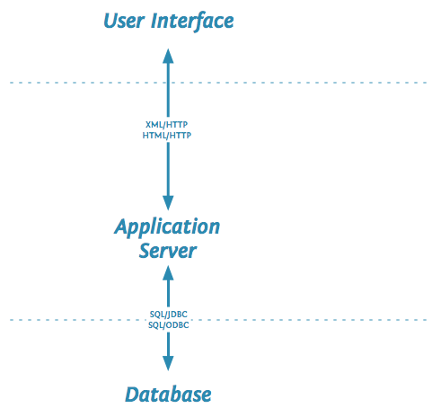


Database Structure

Slide 6

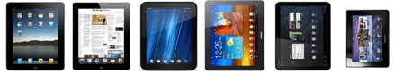
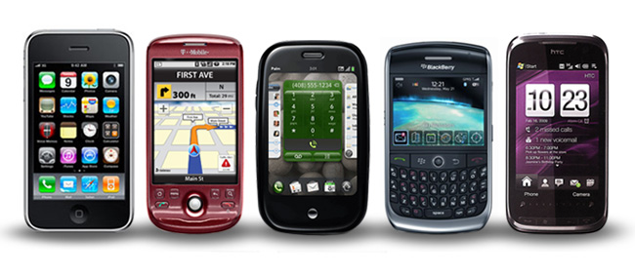
Platforms Used
Web App
Tablet Application
Mobile Application

Slide 7
Competition
Facebook, social website
Outlook, calendar websites
Advantage: Specialized to solving one problem

Slide 8
Benefits and Challenges
Benefits:
Simple and easy to use
Don't need to be added to event to join
Communication with others in the same group
Challenges:
Not as big of a name as its competitors
In the process of globalizing, not available everywhere

Slide 9
Company’s Future
They will continue to expand to different regions of the country
Find what types of groups they collaborate the best
Use that knowledge to optimize service

